Slide 1
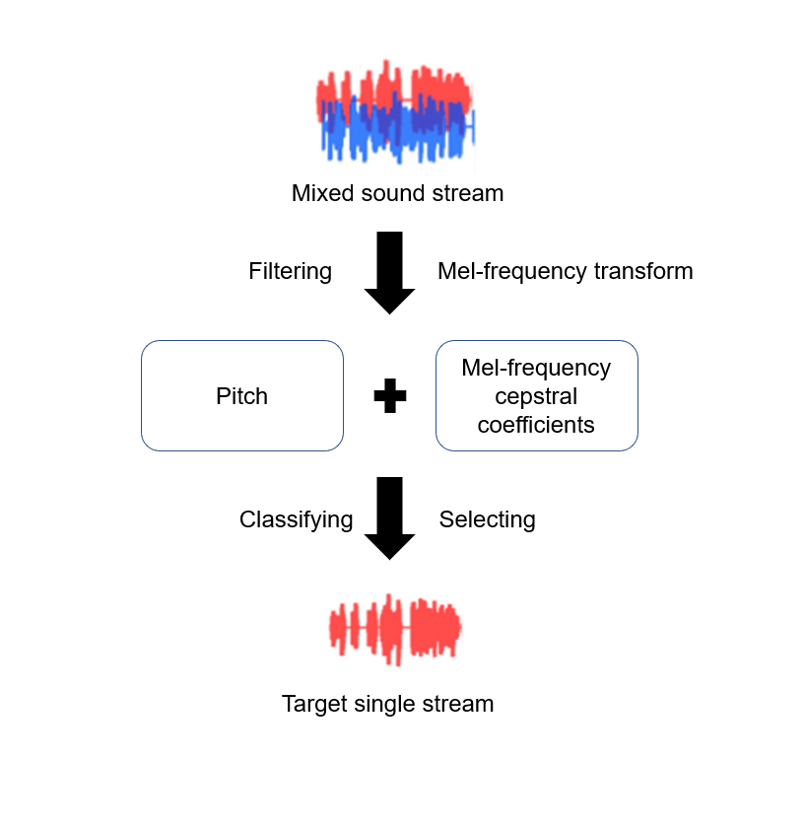
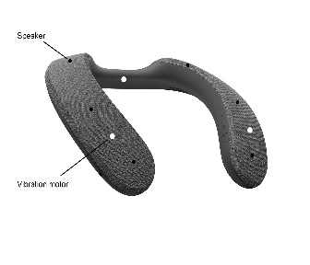
Name of your product/application/system
Hearing assistant system based on deep neural network and wearable surround sound speaker
Introduction
Model and Structure
466 million people, over 5% of the world population, suffer hearing loss in 2021 and over 700 million hearing-impaired are estimated by 2050[1]. This group cannot enjoy most daily experiences due to different degrees of hearing impairment. As one of the most popular entertainment, video games are attractive to people with hearing loss. To help the hearing-impaired immerse themselves in the vertical world, a hearing assistance system and a wearable speaker are proposed.
Figure 1. Model of the deep neural network (left)
and structure of the wearable speaker (right)
Problems and Solutions
People with partial hearing disabilities face a fusion of various sound sources in a noisy environment, so the group fails to separate mixed sound stimuli into single streams and forces one auditory source of interest related to the cocktail party effect[2]. In addition, people with hearing impairment cannot determine the direction of sounds and feel indisposed after long-term wearing hearing aids.
Therefore, a hearing assistant based on the deep neural network (DNN) is designed to deal with these issues for people with partial hearing disabilities. In terms of software, The DNN system consists of a deep autoencoder, a feature extraction network and a classification modulation. There is a description of the work process. All sound sources are collected and filtered for reliable data, then the pitch is calculated and encoded by the deep autoencoder. The next step is that the label data experiences a Mel-frequency transform, widely applied in speech recognition, for reasonable auditory feature representations in the feature extraction network. Finally, the classification modulation realizes the multiple classifications, which can segregate the sound resources and display the feature coefficient on the interface with adjustable buttons. With the assistance of the proposed system, people can hear background music or dialogue to present from an intelligent combination of different sound stimuli. As for the hardware, the wearable surround sound speaker has six speakers and three vibration motors surrounding the arc structure. when users wear this device on the neck and activate it, the speakers and motors play and vibrate at corresponding positions which are related to the direction of sounds in the video game.
Originality, Novelty, Innovativeness
Surround sound and vibration is capable of instructing the hearing-impaired to determine the direction of the source directly, which is more friendly than the conventional auditory guide that plays with background music or dialogue. The assistance system based on DNN imitates the transmission of attention signals to realize the selective attention of the cocktail party effect.
References
[1] World Health Organization, “Deafness and hearing loss”, 1 April 2021, https://www.who.int/news-room/fact-sheets/detail/deafness-and-hearing-loss
[2] M. Gupta, R. K. Singh, and S. Singh, "G-Cocktail: An Algorithm to Address Cocktail Party Problem of Gujarati Language Using Cat Boost," Wireless Personal Communications, vol. 125, no. 1, pp. 261-280, 2022/07/01 2022, doi: 10.1007/s11277-022-09549-6.

